Slide 1
Some results SIMPLE model calibration cocoa Colombia
Angela Romero V
25/08/2021

Slide 2
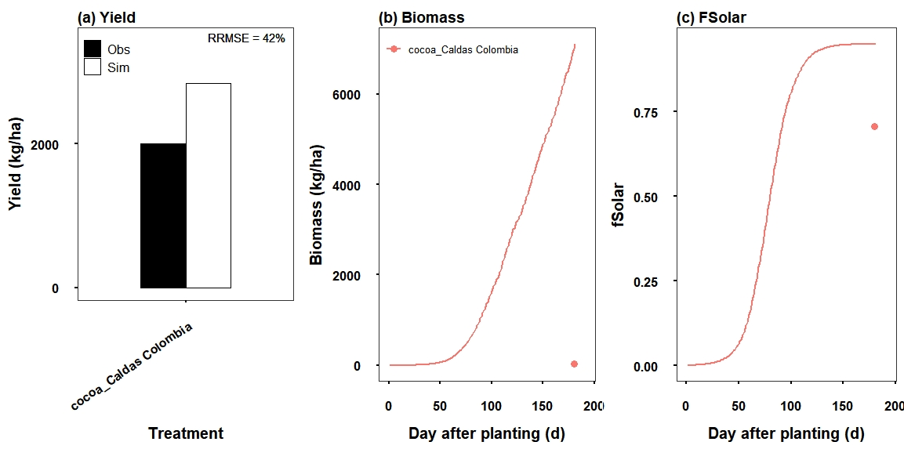
Fedecacao Oscar data
Thermal time 1900cday TB 10 C
1000 plants/ha
LAI = 2
RUE= 0.8
HI= 0.4
Santander
El label decia caldas pero se corrio con el clima de Santander

Slide 3
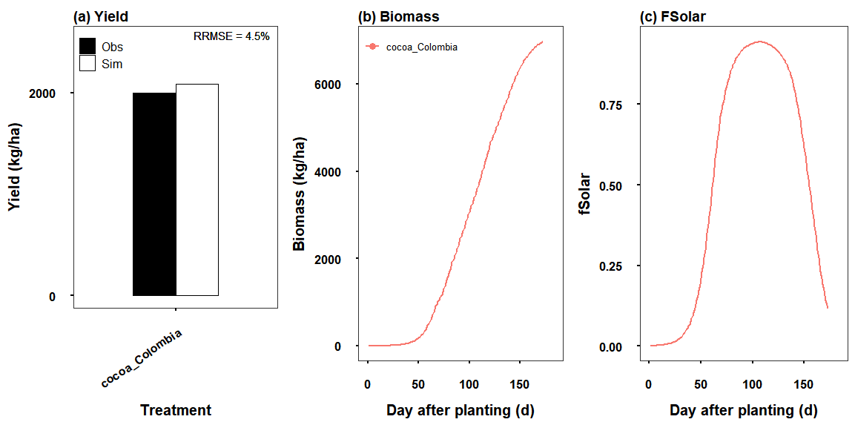
LAI = 1.8
RUE= 0.6
HI= 0.3
DAP = 200
Temperature base 10 C
Thermal time 1912

Slide 4
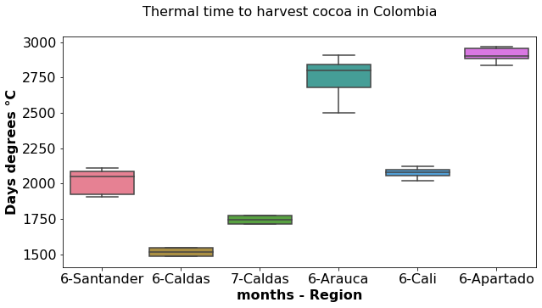
Tb = 10C
Datos Paula Y Adriana

Slide 5
Not water stress considered ARID index 0 Sin viento como input en la ETo
ARID is the ARID index after Woli et al. (2012), which is a
standardized index ranging from 0 (no water shortage) to 1 (extreme
water shortage and associated drought stress). SIMPLE paper
El modelo incluye viento calculado en linea 359 y 411 Mainfunction
ETO[i] <-(0.408*slope*NRAD+PSC*(900/((dat[i,2]+dat[i,3])/2+273))*ws2*
(es-ea))/(slope+PSC*(1+0.34*ws2))

Slide 6
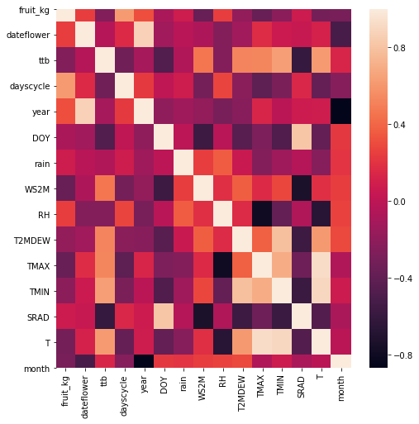
Data weather 4 locations Colombia
WIND IS NOT CORRELATED WITH FLOWERING DATE

Slide 7
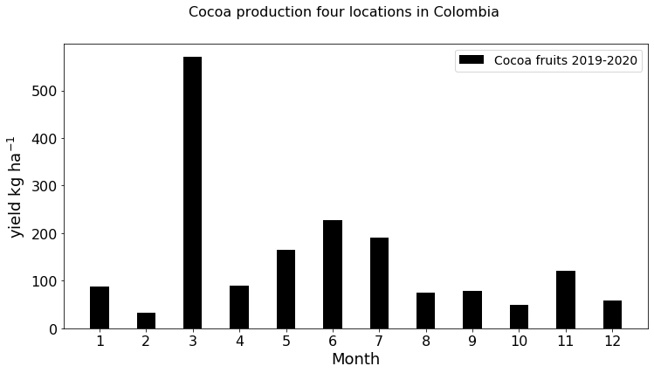
Data 4 locations Colombia

